Slide 1
Cohen chap 3. Center & Spread
“You can, for example, never foretell what any one man will do,
but you can say with precision what an average number will be up to.
Individuals vary, but percentages remain constant.
So says the statistician.”
Sherlock Holmes, The Sign of Four
“We must understand variation.” W. Edwards Deming, American Statistician, 1900-1993
For EDUC/PSY 6600

Slide 2
What do we mean by Distribution?
For a Continuous variable
General shape
Exceptions (outliers)
Modes (peaks)
Center & spread (chap 3)
Histogram
Cumulative polygon or ogive
For a Categorical variable
Counts = raw number of ___ Percent or Rate - adjusts for an ‘out of’ to compare
Bar chart: should have space between bars, order?
Pie chart - avoid!

Slide 3
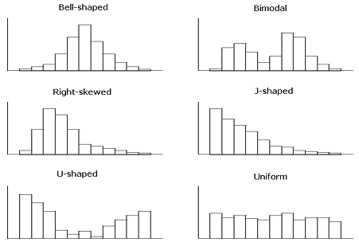
Distribution – examples

Slide 4
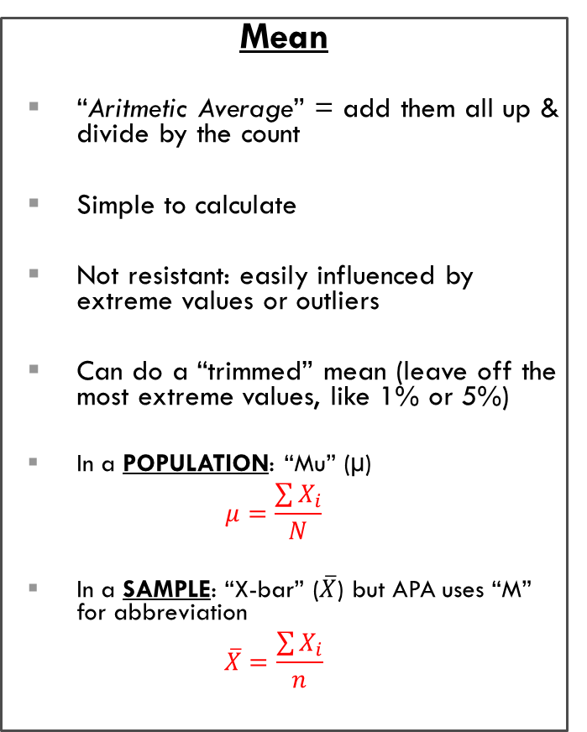
Three Measures of Center
Mean
“Aritmetic Average” = add them all up & divide by the count
Simple to calculate
Not resistant: easily influenced by extreme values or outliers
Can do a “trimmed” mean (leave off the most extreme values, like 1% or 5%)
In a POPULATION: “Mu” (µ)
$$μ=\frac{\sum{X_{i}}}{N}$$
In a SAMPLE: “X-bar” ($\overline{X}$) but APA uses “M” for abbreviation
$$\overline{X}=\frac{\sum{X_{i}}}{n}$$
Mode
“Most” common value, largest frequency, highest peak
Non-uniqueness - can have more than one mode
Doesn’t always represent the ‘center’
Do NOT usually use, other than descriptively
Median
50th percentile, APA: “Mdn”
“Middle” value, when ordered/ranked in increasing order
ODD #: middle value
EVEN #: avg of 2 middle
Half the values are above, and half below
Easy for a computer to do
RESISTANT: NOT influenced by a few extreme values or outliers

Slide 5
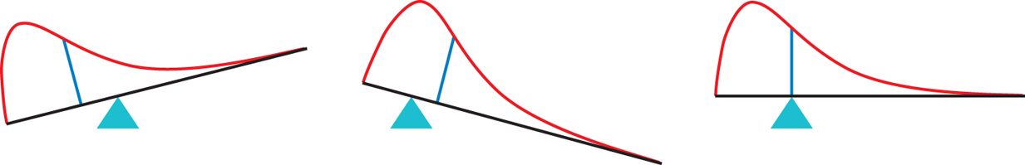
Mean vs Median, with picutres
Median = middle value
It’s the midpoint
If the histogram was chocolate, where would you cut it to share?
Mean = average, not typical
BUT… is ‘pulled’ towards extremes
Visually it is the balance point

Slide 6
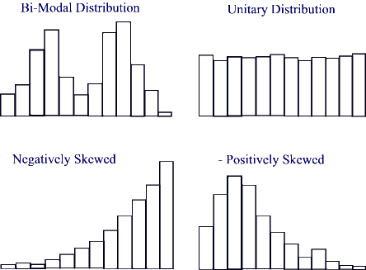
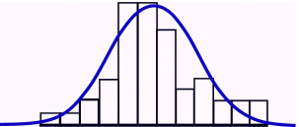
Displaying Distributions with Numbers
Median = middle value
It’s the midpoint
If the histogram was chocolate, where would you cut it to share?
If symetrical →  = M
Left Skewed
Right Skewed
Mean = average, not typical
BUT… is ‘pulled’ towards extremes
Visually it is the balance point.

Slide 7
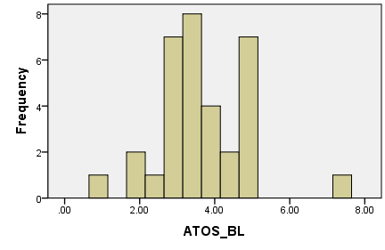
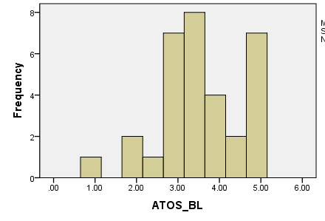
Describing Distributions with Numbers
Median: 3.55 → 3.50
Mean: 3.68 → 3.57
The Median is “resistant” & doesn’t change much
The Mean is “influenced” & changes more!
Average does NOT mean typical

Slide 8
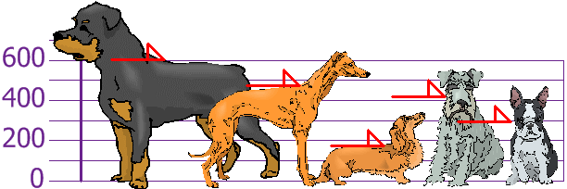
Dog Example
Spread : measured by Variance and Standard deviation
http://www.mathsisfun.com/data/standard-deviation.html
You and your friends have just measured the heights of your dogs
(in millimeters):
The heights (at the shoulders) are:
600mm, 470mm, 170mm, 430mm and 300mm.
Find out the Mean, the Variance, and the Standard Deviation.

Slide 9
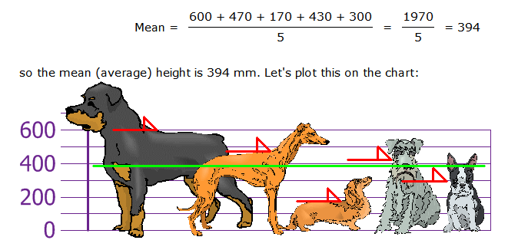
Dog Example: mean

Slide 10
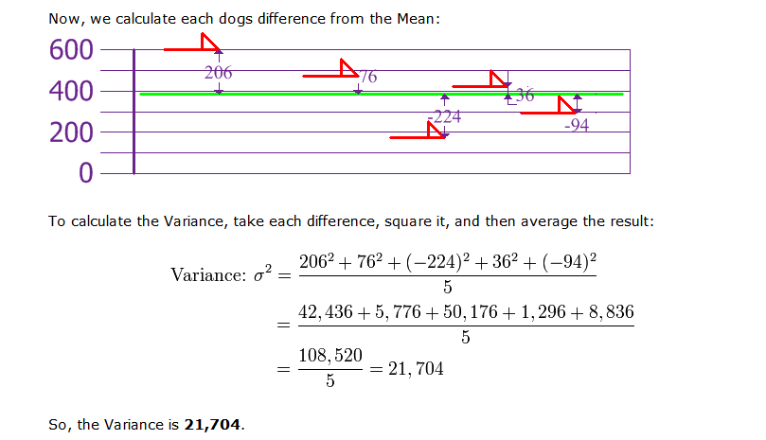
DOG example: Variance
If we didn’t square the deviations, the total would always be zero!
s²
We divide by n-1 because: since we know the deviations all sum up to zero, if we know all but the last one, we can subtract to find it
27,130 mm²

Slide 11
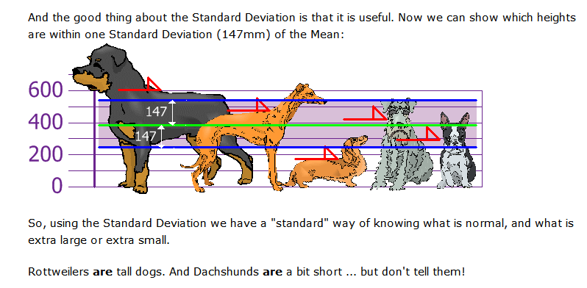
DOG EXAMPLE: Standard deviation

Slide 12
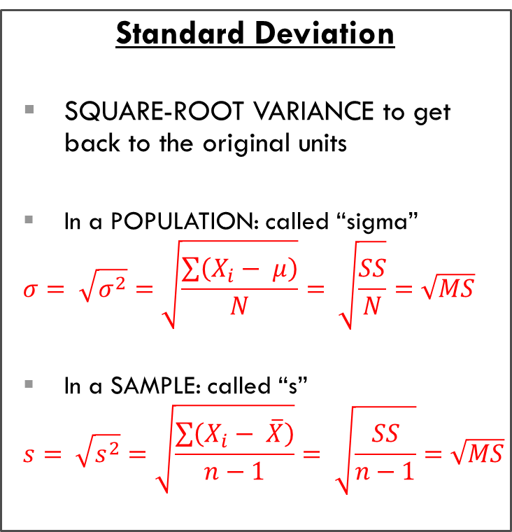
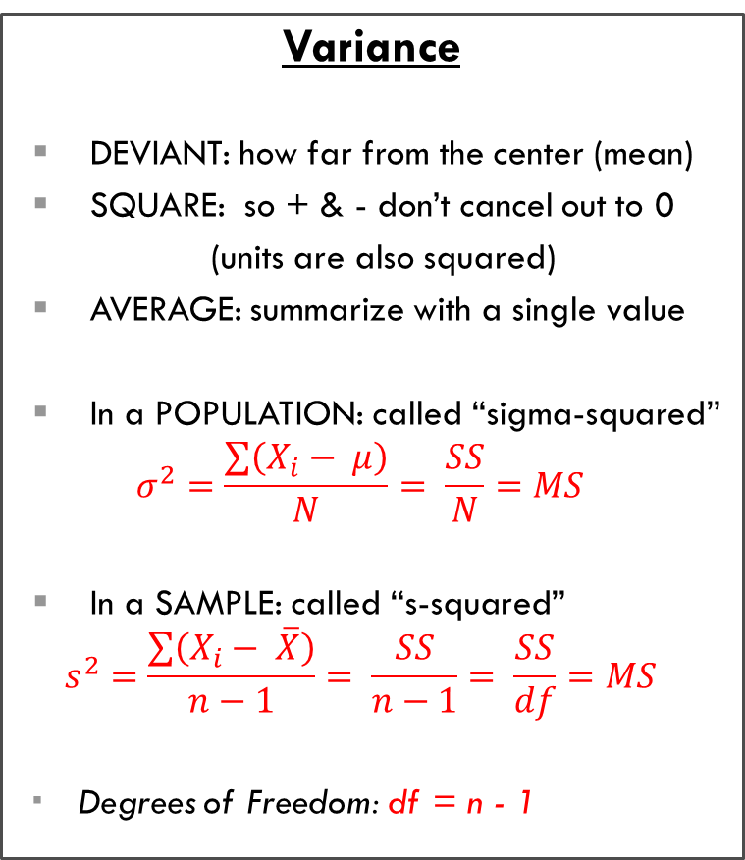


Three Measures of SPREAD
$$Sum of Squares$$
$$SS=\sum{{\left(X_{i}−mean\right)}^{2}}$$
$$Mean Sum of Squres$$
$$MS=\frac{SS}{df}$$
Variance
DEVIANT: how far from the center (mean)
SQUARE: so + & - don’t cancel out to 0
(units are also squared)
AVERAGE: summarize with a single value
In a POPULATION: called “sigma-squared”
$$σ^{2}=\frac{\sum{\left(X_{i}− μ\right)}}{N}= \frac{SS}{N}=MS$$
In a SAMPLE: called “s-squared”
$$s^{2}=\frac{\sum{\left(X_{i}− \overline{X}\right)}}{n−1}= \frac{SS}{n−1}= \frac{SS}{df}=MS$$
Degrees of Freedom: df = n - 1
Range, IQR, & SIR
Range = Max – Min
Interquartile Range
IQR = Q3 – Q1
Semi-Interquartile Range
SIR = (Q3 – Q1) / 2
Range is super dependent on extreme values or outliers
IRG & SIR more resistant
Standard Deviation
SQUARE-ROOT VARIANCE to get back to the original units
In a POPULATION: called “sigma”
$$σ= \sqrt{σ^{2}}=\sqrt{\frac{\sum{\left(X_{i}− μ\right)}}{N}}= \sqrt{\frac{SS}{N}}=\sqrt{MS}$$
In a SAMPLE: called “s”
$$s= \sqrt{s^{2}}=\sqrt{\frac{\sum{\left(X_{i}− \overline{X}\right)}}{n−1}}= \sqrt{\frac{SS}{n−1}}=\sqrt{MS}$$

Slide 13
Best summaries?
“…the perfect estimator does not exist.”
Rand Wilcox, 2001
Which is better to convey a distribution with numbers?
Median & SIR
Mean & standard deviation
!!! A graph gives the best overall picture of a distribution. Number of center/spread convey only some information…
… ALWAYS PLOT YOUR DATA!!!
Skewed data or outliers
resistant to extreme values
Symmetrical and no outliers
NOT resistant to extreme values

Slide 14
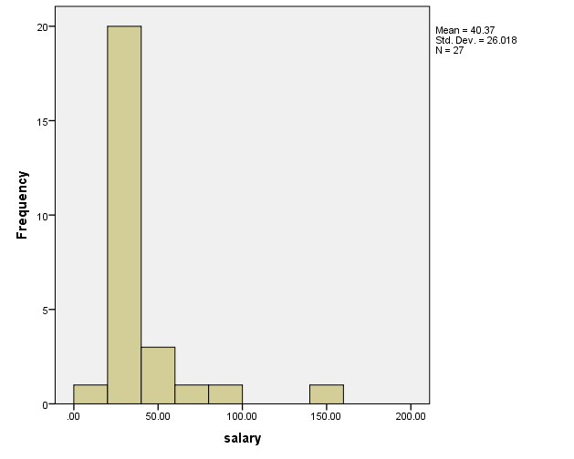
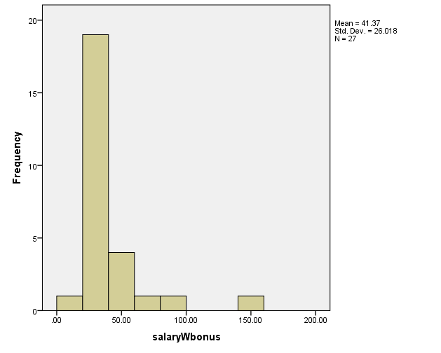
ADD a constant amount to everyone
Give everyone a $1000 bonus (add the same amount)

Slide 15
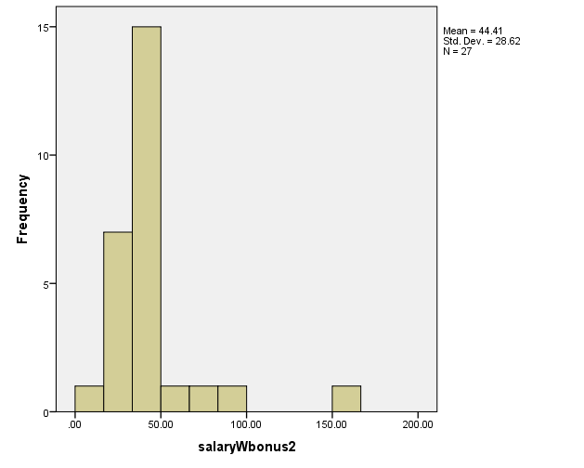
Multiply all by the same constant
Give everyone a 10% bonus (multiply by same amount)

Slide 16
Properties of the MEAN & standard deviation
If you ____________ the same CONSTANT number Onto every score… | MEAN | STANDARD DEVIATION
ADD (or subtract) | ADD (or subtract) SAME amount | unchanged
MULTIPLY (or divide) | MULTIPLY (or divide) by the SAME amount | MULTIPLY (or divide) by the SAME amount

Slide 17
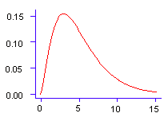
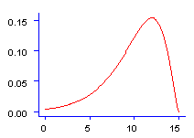
Skewness
Positive
skewness
Degree of symmetry in distribution
Can detect visually (histogram or boxplot)
Skewness statistic
Based on cubed deviations
from M (returns statistic to original units)
Divided by SE of skewness
> ± 2 indicates likely problem with skewness
Interpreting skewness statistic
Positive value = Positive (right) skew
Negative value = Negative (left) skew
Zero value = No skew
No
skewness
Negative
skewness

Slide 18
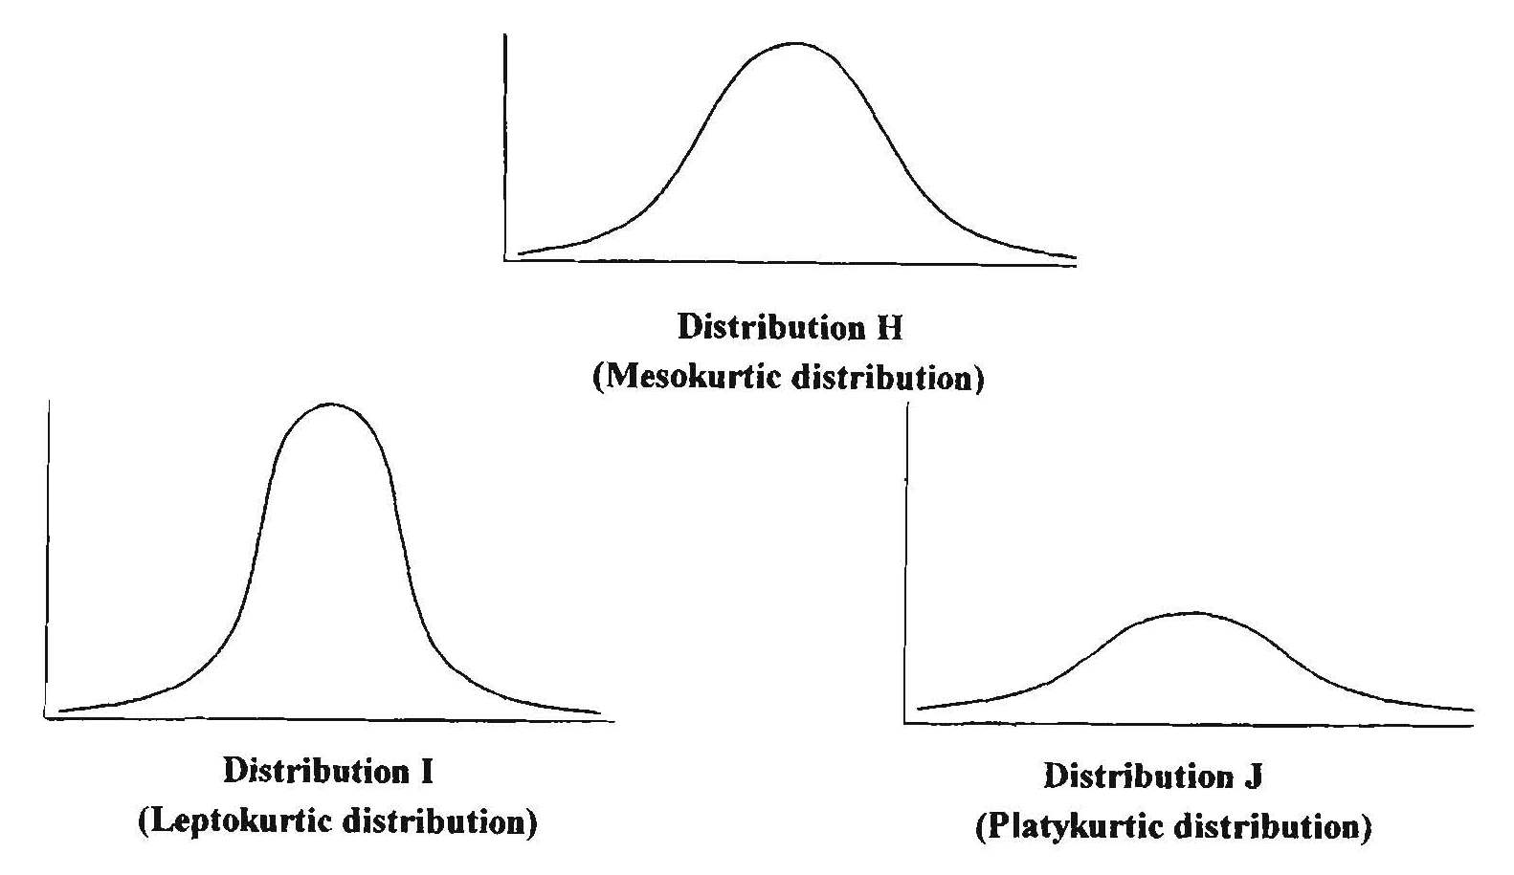
KURTOSIS
Degree of flatness in distribution
Harder to detect visually
Kurtosis statistic
Based on deviations
from M raised to 4th power (returns statistic to original units)
Divided by SE of kurtosis
> ± 2 indicates likely problem with kurtosis
Interpretation of kurtosis statistic
Positive kurtosis = leptokurtic (peaked)
Negative kurtosis = platykurtic (flat)
Zero value = mesokurtic (normal)

Slide 19

Example of VERY small amount of data (usually lots more)
77, 79, 80, 86, 87, 87, 94, 99
Min = 77
Q1 = 79.5
M = 86.5
Q3 = 90.5
Max = 99
Five-number summary = 77, 79.5, 86.5, 90.5, 99
IQR = 90.5 – 79.5 = 11
SQR = 11 / 2 = 5.5
Box-Plot = connect lines plotted above

Slide 20
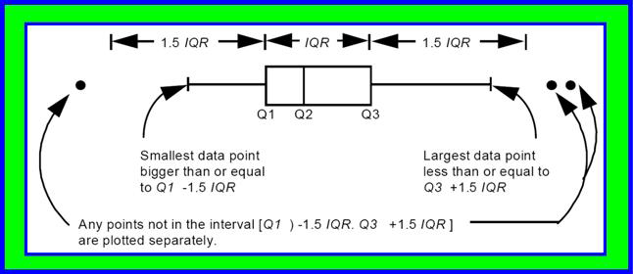
Modified Box plot
only let the ‘whiskers’ extend out to 1.5 x IQR and any points beyond that are represented with dots…these are suspected outliers to be investigated

Slide 21
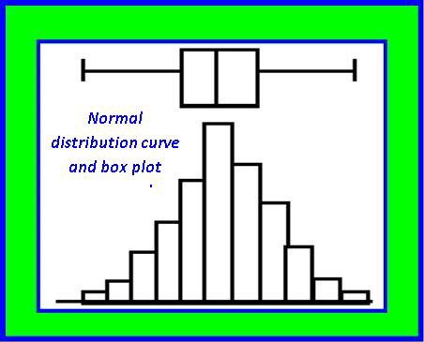
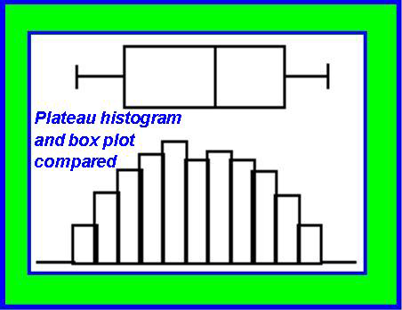
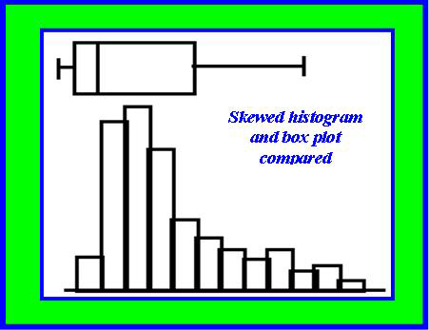
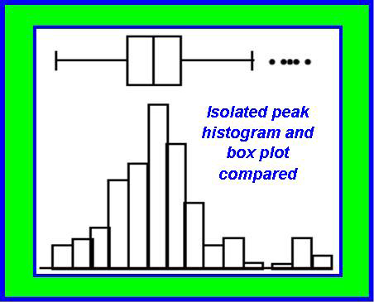
Boxplot vs. histogram

Slide 22
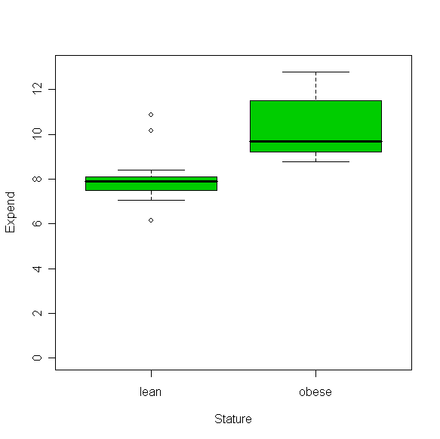
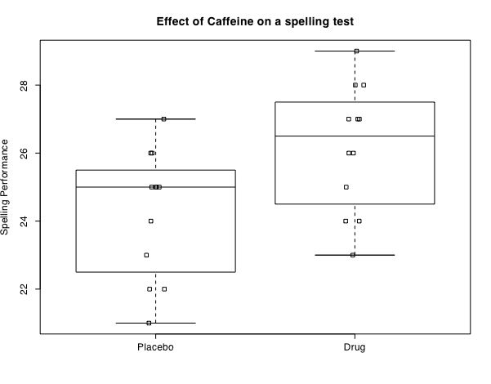
Box plots: comparing groups examples
Figure 6. Boxplots of energy expenditure during 20 minutes of physical activity in lean (n = 11) and obese (n = 11) males.

Slide 23
(kernel) density plots
Smoothed histogram
Non-parametric plotting technique that estimates a variable’s probability distribution
Specify…
Smoothing window: Symmetric range of values about each value
Bandwidth (bw) distance: Distance from edge of window to center (2d = smoothing window width)
Adjacent values within window of frequency distribution are averaged, resulting in a smoothed plot

Slide 24
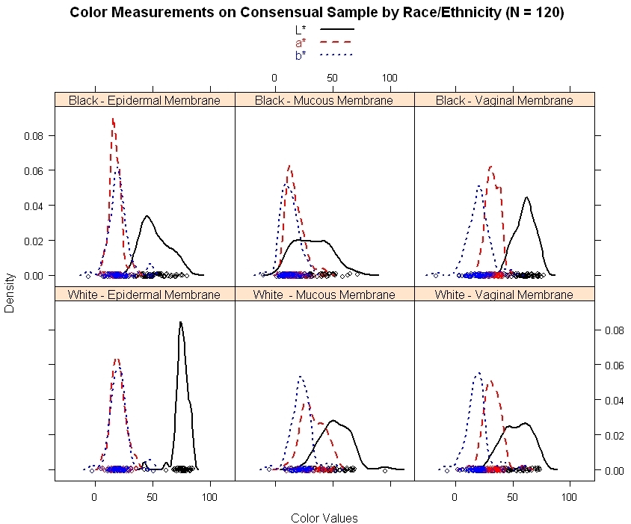
(kernel) density plots - example

Slide 25
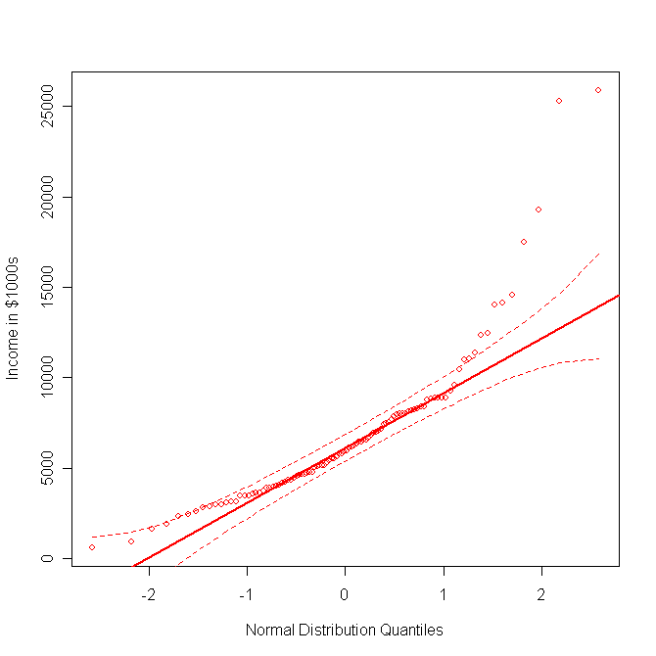
Quantile-Quantile (Q-Q) Comparison Plot
Scatterplot: Observed vs. theoretical distribution
Theoretical can be any type: Normal, Poisson, etc.
If observed variable follows chosen distribution, coordinate points will fall along 45º line w/in 95% confidence envelope
Best method for evaluating normality; other methods better for evaluating symmetry and outliers

Slide 26
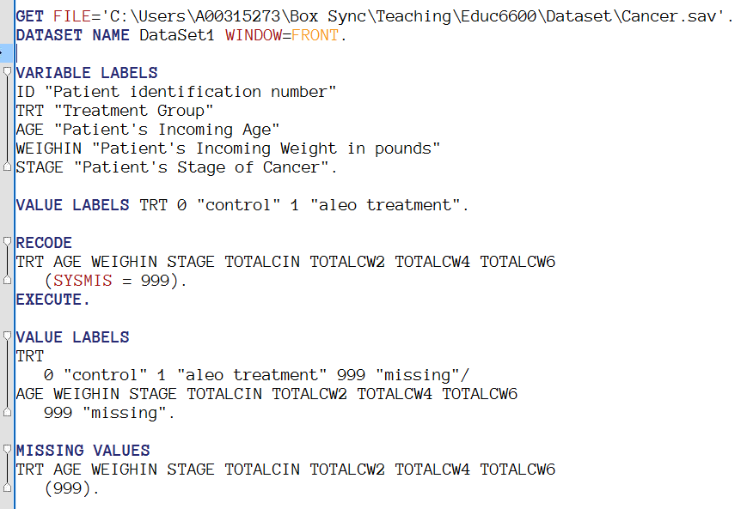
Example: cancer dataset
Available on Canvas
Save to your computer
Edit the path to match

Slide 27
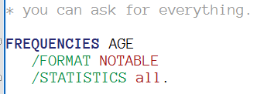
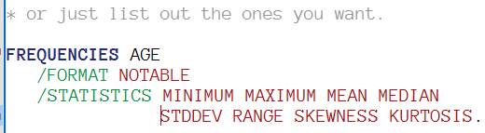
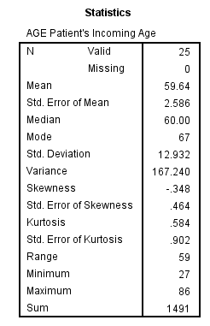
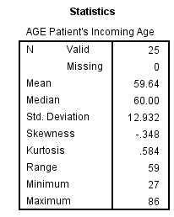
SPSS: summary statistics w/freq

Slide 28
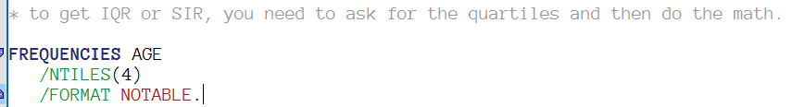
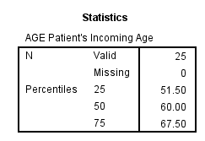
SPSS: summary statistics w/freq
IQR = Q3 – Q1 = 67.50 – 51.50 = 16.00
SIR = IQR / 2 = 16.00 / 2 = 8.00

Slide 29
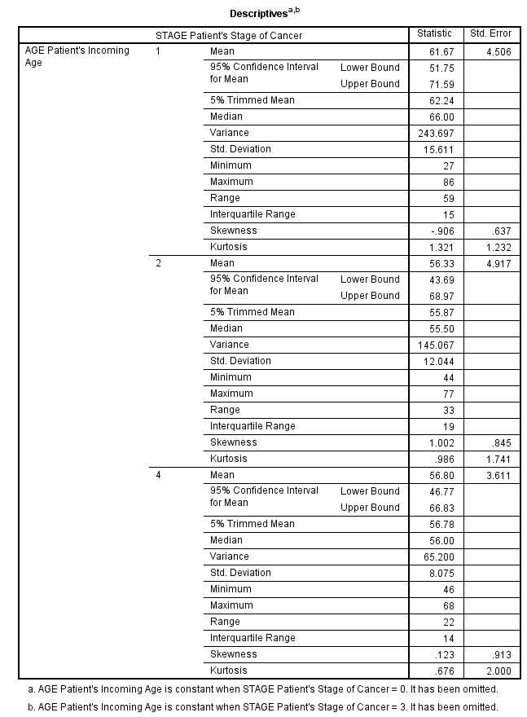
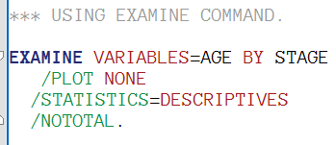
SPSS: summary statistics for each group

Slide 30
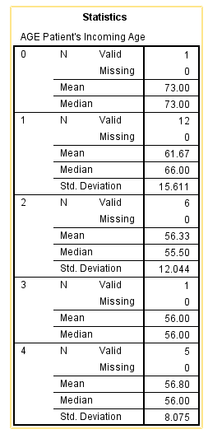
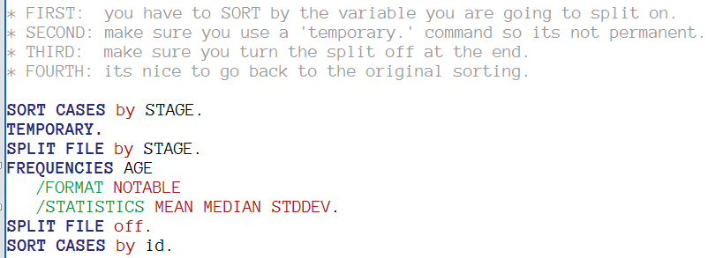
SPSS: summary statistics for each group

Slide 31
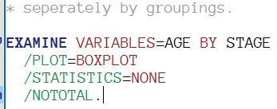

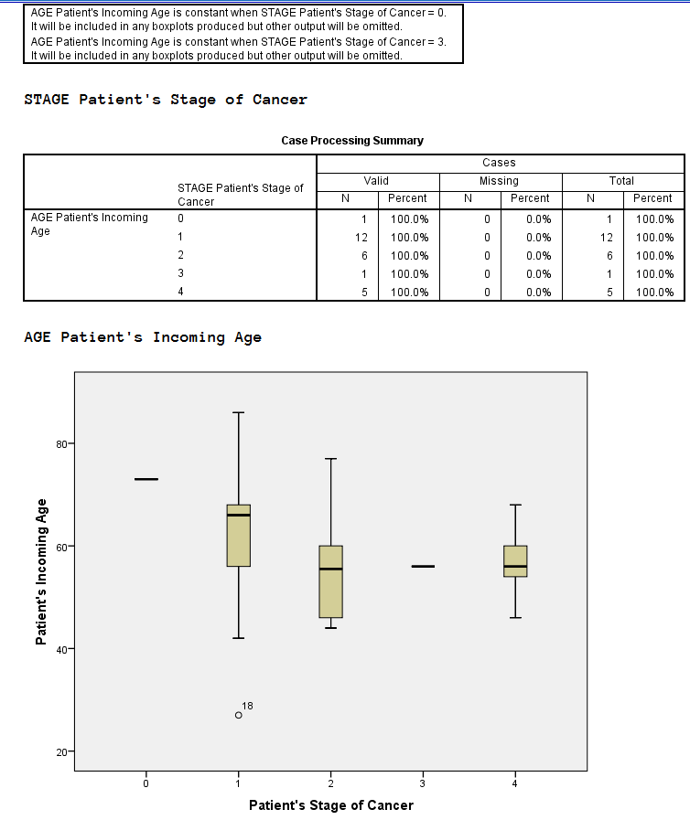
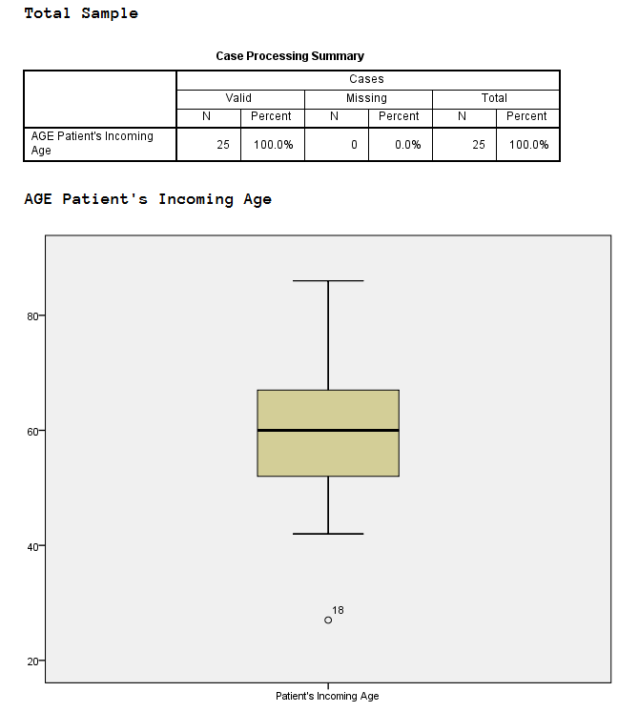
SPSS: Create boxplots

Slide 32
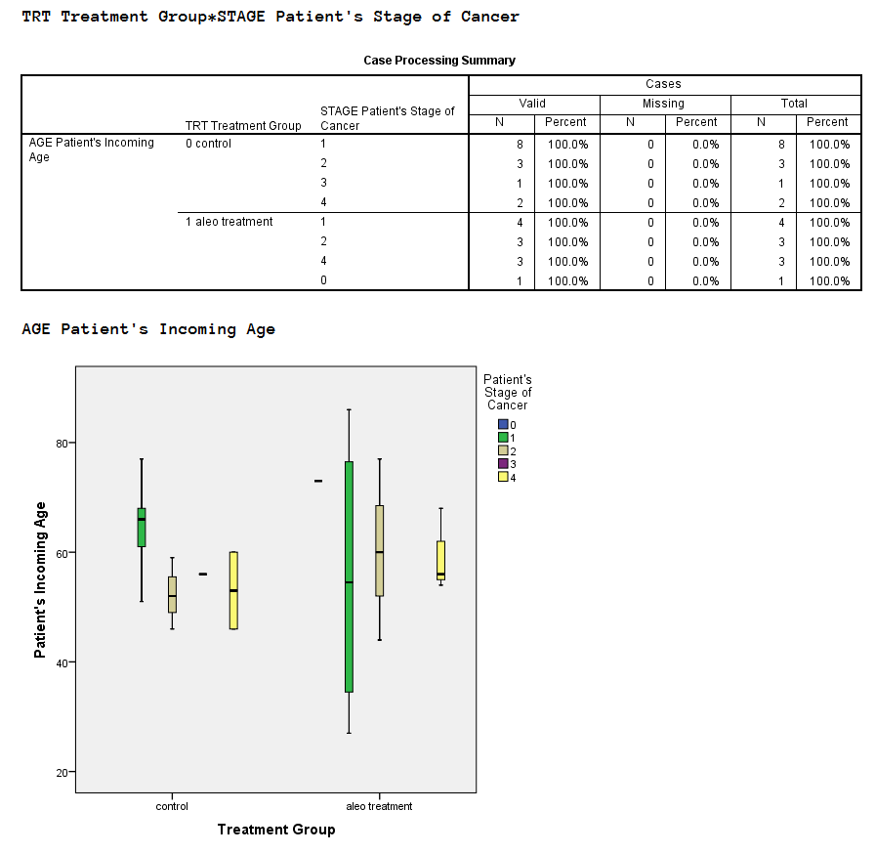
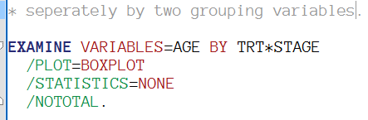
SPSS: Create boxplots

Slide 33
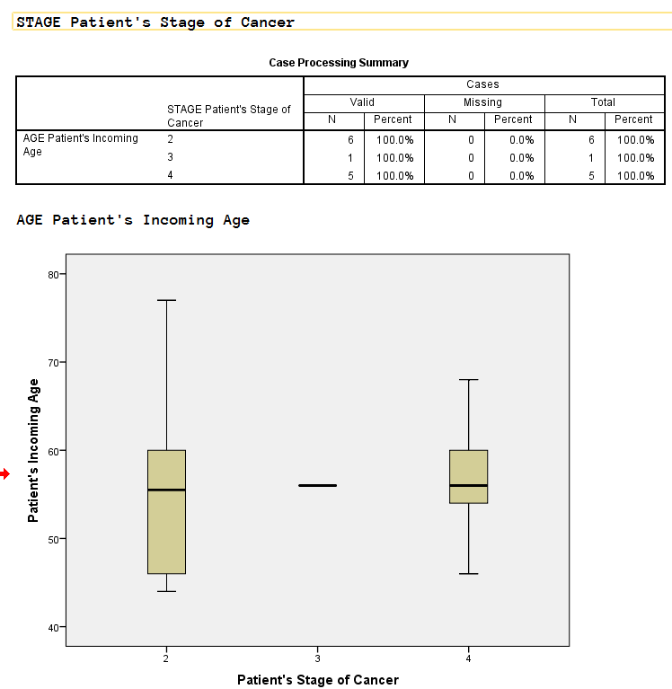
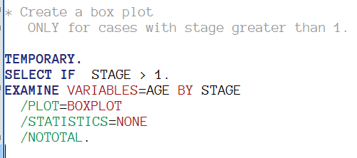
SPSS: restricting cases

Slide 34
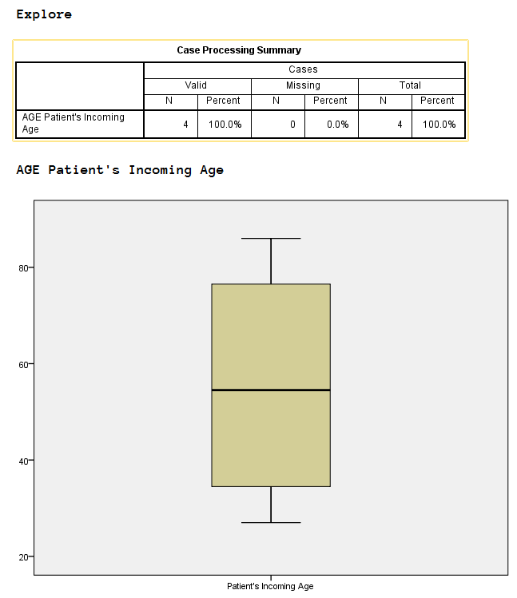
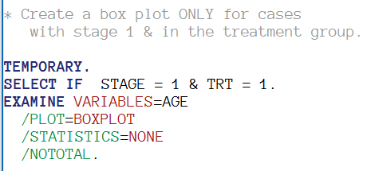
SPSS: restricting cases

